Slide 1
SharePoint Framework M8
Jenkins NS
@jenkinsns

Slide 2

Agenda
Module 8: Loading SharePoint Data in a client web part
Loading SharePoint data
Page Context
Web Services Overview
REST and ODATA Fundamentals
SharePoint REST API’s
Framework HTTP Client
Solving cross domain issues with CORS
Microsoft Graph API Integration
Microsoft Graph API Tool kit

Slide 3
Page Context
The page context provides standard definitions for common SharePoint objects that need to be shared between the client-side application, web parts, and other components. Typically the data is fetched via REST queries when navigating to a new page, but it can also be preloaded by the web server or filled from a custom application cache.
Provides access to information about current context
Greatly extended version of _spPageContextinfo
Property | Description
aadInfo | If the current page doesn't have an associated Azure Active Directory tenant, this property will be undefined
cultureInfo | It provides culture info for the current user of the application
isInitialized | Returns whether the PageContext has been initialized
list | Contextual information for the SharePoint list that is hosting the page. If there is no list associated to the current page, this property will be undefined
listItem | Contextual information for the SharePoint list item that is hosting the page. If there is no list item associated to the current page, this property will be undefined
site | Contextual information for the SharePoint site collection ("SPSite") that is hosting the page.
user | It provides contextual information for the SharePoint user that is accessing the page. This class is primarily used with the PageContext class.
web | Contextual information for the SharePoint site ("SPWeb") that is hosting the page.

Slide 4
Page Context …
Examples
import { SPPermission } from '@microsoft/sp-page-context’;
this.context.pageContext.web.absoluteUrl
this.context.pageContext.web.permissions.hasAllPermissions(SPPermission.fullMask);
hasAllPermissions : Checks if the user has all the permissions
this.context.pageContext.web.permissions.hasAnyPermissions(SPPermission.manageWeb);
hasAnyPermissions: Checks if the user has any permission from the collection of permissions
this.context.pageContext.web.permissions.hasPermission(SPPermission.viewPages);
has Permission: Checks if the user has given permission

Slide 5
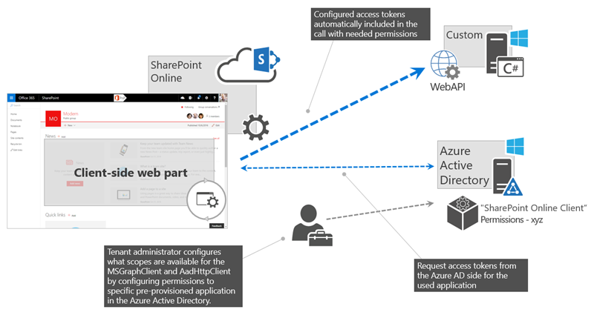
Web Services Overview
Scenario: Customer is having existing web service which is developed into ASP.NET. Currently, we need to develop SPFx web part for SharePoint application. We want to fetch some information using this web service and need to populate into this webpart.
How is authentication handled in the ASP.NET web service?
Answer: By using the AadHttpClient, you can easily connect to APIs secured by using Azure AD without having to implement the OAuth flow yourself
Developers building client-side solutions are responsible for implementing authorization by using the OAuth implicit flow in their application. In SharePoint Framework solutions, that's already done as part of the framework through MSGraphClient and AadHttpClient, both of which are introduced in SharePoint Framework v1.4.1.
Note : If you build solutions on a version of the SharePoint Framework earlier than v1.4.1, you can still connect to resources secured with Azure AD. In this case, you need to implement the OAuth implicit flow by using ADAL JS.
Notes:
https://docs.microsoft.com/en-us/sharepoint/dev/spfx/use-aadhttpclient

Slide 6
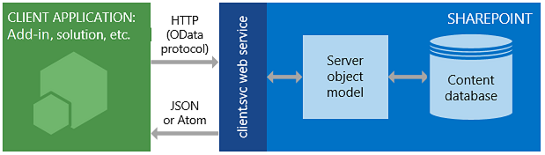
SharePoint REST API’s
SharePoint includes a Representational State Transfer (REST) service that is comparable to the existing SharePoint client object models. Developers can interact remotely with SharePoint data by using any technology that supports REST web requests. This means that developers can perform Create, Read, Update, and Delete (CRUD) operations from their SharePoint Add-ins, solutions, and client applications, using REST web technologies and standard Open Data Protocol (OData) syntax.
To access SharePoint resources using REST, construct a RESTful HTTP request by using the OData standard, which corresponds to the desired client object model API.
https://{site_url}/_api/web
https://{site_url}/_api/site
Example
https://jpower4dev.sharepoint.com/_api/web/lists/GetByTitle('Contactlist')/Items
URL end Points – Some exaples | Description
web/title | Retrieves the title of a list
Lists | Retrieves all lists on a site
lists/getbytitle('listname') | Retrieves a single list's metadata
lists/getbytitle('listname')/items | Retrieves items within a list
lists/getbytitle('listname')?select=Title | Retrieves a specific property of a document

Slide 7
Using HttpClient
HttpClient implements a basic set of features for performing REST operations against a generic service.
import { HttpClient, IHttpClientOptions, HttpClientResponse } from '@microsoft/sp-http’
If you already used the HttpClient and SPHttpClient in your SharePoint Framework projects, you might have noticed that you have two types of request methods options: GET and POST. These two types of requests are the most used ones, but what if you want to use other HTTP methods like PUT, PATCH, DELETE?
If you need to make calls with other HTTP methods, you can make use of the fetch which is available on both the HttpClient and SPHttpClient classes. The fetch method allows you to specify the HTTP method type per request yourself. Fetch is also used behind the scenes when you are using the GET and POST methods.
how you can make use of the fetch method and specifying the request method to perform: spHttpClient
this.props.context.spHttpClient.fetch(restUrl, SPHttpClient.configurations.v1, {
method: "PATCH",
body: JSON.stringify({
"Something": "Some content to patch" })
}).then((response: SPHttpClientResponse) => { // Do your thing});
with the HttpClient, but you will notice that is not that different to use:
this.props.context.httpClient.fetch(restUrl, HttpClient.configurations.v1,
{ method: "DELETE"})
.then((response: HttpClientResponse) => { // Do your thing
});zax

Slide 8
Loading SharePoint data
SharePoint Framework is the new development model and it is a page and Web part model which provides full support for client-side SharePoint development, easy integration with SharePoint data, and support for open-source tooling.
Standard “features” of SPFx
ToolchainAuthenticationSP
GraphAPI and WebAPI Access
CDN hosting
Config experience
Solution hosting
Component is able to get the right application context
Tenant-wide Deployment

Slide 9


Slide 10
Fluent UI
Overview
Fluent UI for the web is available in two flavors: Fluent UI React and Fabric Core.
Fluent UI React
Fluent UI React is the official open-source React front-end framework designed to build experiences that fit seamlessly into a broad range of Microsoft products. It provides robust, up-to-date, accessible components which are highly customizable using CSS-in-JS. Get started with Fluent UI React
Fabric Core
Fabric Core is an open-source collection of CSS classes and Sass that give you access to colors, animations, fonts, icons and grid. Get started with Fabric Core

Slide 11
Fluent UI React
Getting started developing with Fluent UI React is simple!
Add to existing project
Fluent UI React is available via the @fluentui/react npm package. To use this package in an existing project
npm install @fluentui/react
To Use the control
import { PrimaryButton } from '@fluentui/react';

Slide 12
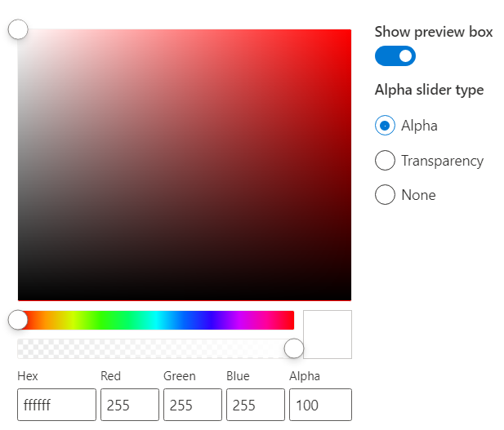
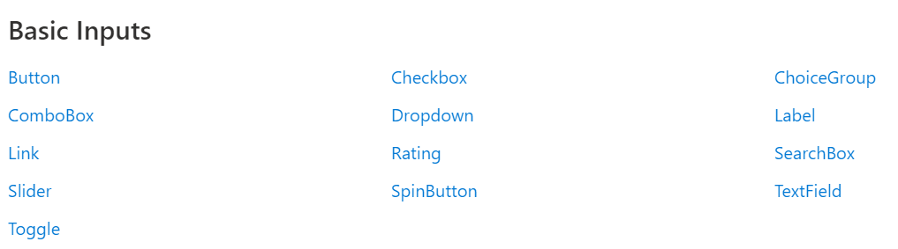
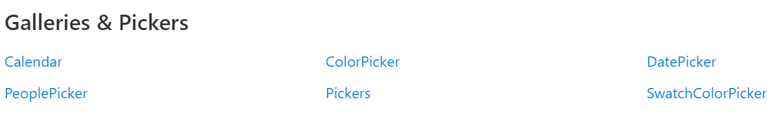
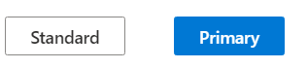
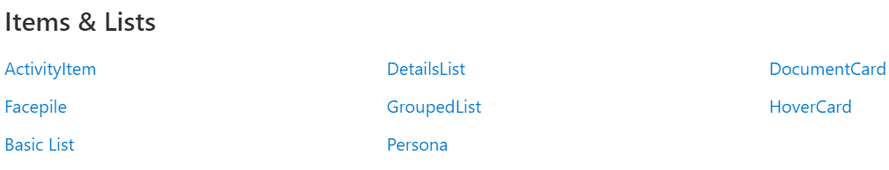
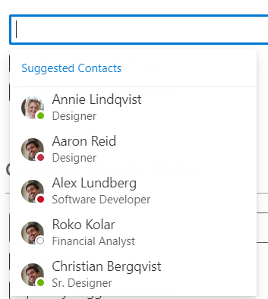
Fluent UI Controls
https://developer.microsoft.com/en-us/fluentui#/controls/web

Slide 13
Host your client-side web part from Microsoft 365 CDN
"includeClientSideAssets": true - The default value for the includeClientSideAssets is true, which means that static assets are packaged automatically in the *.sppkg files, and you don't need to separately host your assets from an external system.
gulp build
gulp bundle --ship
gulp package-solution –ship
package on the SharePoint/solution folder.

Slide 14
Enable Public CDN
Office 365 Content Delivery Network (CDN)
Microsoft introduced Office 365 CDN capability, which is used to host your assets directly from your Office 365 Tenant and it can be accessed by SharePoint sites and add-ins with the help of CDN URLs.
Prerequisites to enable Public CDN
Download SharePoint Online Management Shell
Steps involved to enable Public CDN
Open SharePoint Online Management Shell.
Run the command given below in the Management Shell to connect to your SharePoint Online Tenant
Connect-SPOService -Url https://Jpower4mvp-admin.sharepoint.com
Run the command given below to enable CDN in your Tenant.
Set-SPOTenantCdnEnabled -CdnType Public
Create SPSite and Create a new document library in one of your SharePoint Online sites within your Tenant. I have created a folder , which will be added as new CDN origin.
Run the command given below to add a new CDN origin.
Add-SPOTenantCdnOrigin -CdnType Public -OriginUrl sites/JPOWER4/cdn
Run the command given below to get all public Tenant CDN origins.
Get-SPOTenantCdnOrigins -CdnType Public
Assets hosted in public CDN origins can be accessed by public CDN URL.
https://publiccdn.sharepointonline.com/<tenant host name>/sites/site/library

Slide 15
Office 356 APIs
Service | Functionality | Base URL
Azure AD Graph | User, Groups Application, Devices | https://graph.windows.net
Exchange Online | Mail, Calendar, Contacts | https://outlook.office365.com/api
SharePoint Online | List, Libraries, Search, User Profiles | https://tenant.sharepoint.com/_api
OneDrive for Business | Files, Folders | https://tenant-my.sharepoint.com/_api
OneNote | Notebooks,Pages | https://onenote.com/api
Yammer | Conversations | https://yammer.com/api
Stream | Videos, Channels | https://tenant.sharepoint.com/portals

Slide 16



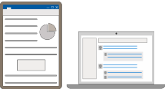
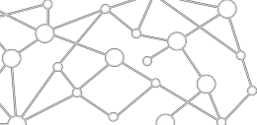

STANDALONE WEB, DEVICE, AND SERVICE APPS
Conversation are Core to the Office 365 Platform
EXTENSIONS


EMBEDDED CANVASES
Microsoft Graph
External Data & Content

Slide 17
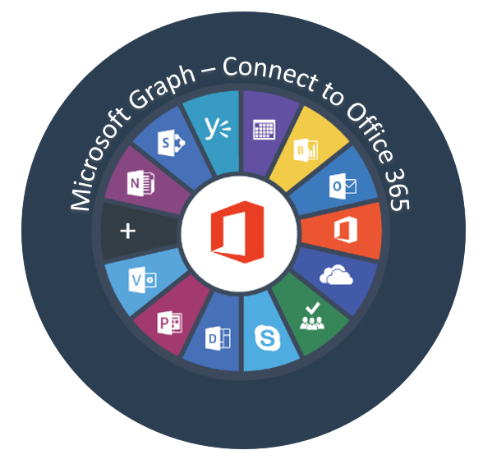
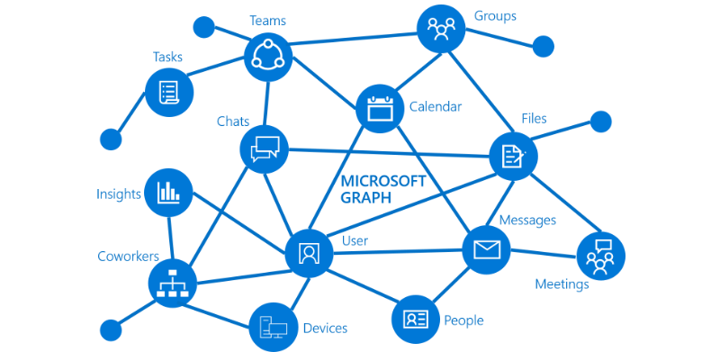
Overview of Microsoft Graph

Slide 18
What is Graph API?
Microsoft Graph exposes REST APIs and client libraries to access data on the following Microsoft 365 services:
Office 365 services: Delve, Excel, Microsoft Bookings, Microsoft Teams, OneDrive, OneNote, Outlook/Exchange, Planner, and SharePoint
Enterprise Mobility and Security services: Advanced Threat Analytics, Advanced Threat Protection, Azure Active Directory, Identity Manager, and Intune
Windows 10 services: activities, devices, notifications
Dynamics 365 Business Central

Slide 19
Microsoft Graph
Access user, group and organizational data
One endpoint One token
All users
Your App
https://graph.microsoft.com
Users
More…
#SPTechCon
Groups
SharePoint
Outlook
OneNote
Planner
Teams
Excel
Intune
Azure AD

Slide 20
Consume Microsoft Graph
You can now implement the below methods to consume the Microsoft Graph. You have two options:
Use the AadHttpClient client object
Use the MSGraphClient client object
SharePoint Framework v1.6.0 onwards supported consuming the MS Graph APIs and custom APIs.
Note:
SharePoint Framework v1.4.1 beta onwards MS Graph APIs supported.
You can consume the Microsoft Graph API with versions of SharePoint Framework earlier than v.1.4.1, either via the native graphHttpClient, or via a manual ADAL JS implicit OAuth flow.

Slide 21
AadHttpClient
AadHttpClient
The AadHttpClient client object is useful for consuming any REST API. You can use it to consume Microsoft Graph or any other third-party (or first-party) REST API and “AadHttpClient” is used to perform REST calls against an Azure AD Application, for example 3rd party WebAPI hosted in Azure.
For communicating with SharePoint, use the “SPHttpClient” class instead.
For communicating SharePoint with Microsoft Graph, use the MSGraphClient class.
this.props.context.aadHttpClientFactory
.getClient('https://graph.microsoft.com’)
.then((client: AadHttpClient) => {
// Search for the users with givenName, surname, or displayName equal to the searchFor value
return client .get( `https://graph.microsoft.com/v1.0/users?$select=displayName,mail,userPrincipalName&$filter=(givenName%20eq%20'${escape(this.state.searchFor)}')%20or%20(surname%20eq%20'${escape(this.state.searchFor)}')%20or%20(displayName%20eq%20'${escape(this.state.searchFor)}')`, AadHttpClient.configurations.v1
);
})
.then(response => {
return response.json();
})

Slide 22
MSGraphClient object
MSGraphClient
“MSGraphClient” is used to perform REST calls against Microsoft Graph. The Microsoft Graph JavaScript client library is a lightweight wrapper around the Microsoft Graph API. This class allows developers to start making REST calls to MSGraph without needing to initialize the MSGraph client library.
The MSGraphClient client object can consume the Microsoft Graph only. Internally it uses the AadHttpClient client object and supports the fluent syntax of the Microsoft Graph SDK.
Supported from SPFx v1.4.1 (Initial beta release of MSGraphClient class)
MSGraphClient is a new HTTP client introduced in SharePoint Framework v1.6.0
this.props.context.msGraphClientFactory
.getClient()
.then((client: MSGraphClient): void => {
// From https://github.com/microsoftgraph/msgraph-sdk-javascript sample
client
.api("users")
.version("v1.0")
.select("displayName,mail,userPrincipalName")
.filter(`(givenName eq '${escape(this.state.searchFor)}') or (surname eq '${escape(this.state.searchFor)}') or (displayName eq '${escape(this.state.searchFor)}')`)
.get((err, res) => {
if (err) { console.error(err); return; }

Slide 23
API Permissions
To consume Microsoft Graph or any other third-party REST API, you need to explicitly declare the permission requirements from an OAuth perspective in the manifest of your solution.
In the SharePoint Framework v.1.4.1 or later, you can do that by configuring the webApiPermissionRequests property in the package-solution.json under the config folder of the solution.
Microsoft Graph permission names follow a simple pattern: resource.operation.constraint..Read grants permission to read the profile of the signed-in user.
User.ReadWrite grants permission to read and modify the profile of the signed-in user and
Mail.Send grants permission to send mail on behalf of the signed-in user.
"webApiPermissionRequests": [
{
"resource": "Microsoft Graph",
"scope": "User.ReadBasic.All"
}
]
https://docs.microsoft.com/en-us/graph/api/resources/team?view=graph-rest-1.0
Notes:
https://docs.microsoft.com/en-us/graph/api/resources/team?view=graph-rest-1.0
https://developer.microsoft.com/en-us/graph/graph-explorer#
https://docs.microsoft.com/en-us/graph/permissions-reference

Slide 24
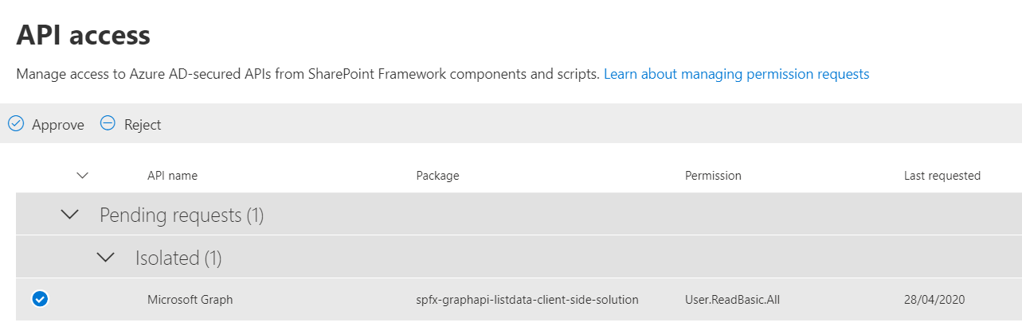
API access

Slide 25
Isolated Webparts

Slide 26
Why Isolated web parts?
To allow your SharePoint Framework solutions to securely access APIs secured with Azure AD, you can use the API management to specify which APIs can be accessed by scripts in your tenant and with which permissions.
Using the SharePoint Framework, you can easily retrieve an access token for the specific API.
While it significantly simplifies communicating with APIs secured with Azure AD, it allows all scripts, not just specific SharePoint Framework solutions, to obtain an access token for any of the approved APIs. If one of the scripts you use in your tenant was exploited, then it could access any of the approved APIs on behalf of the current user.
SharePoint Framework v1.8.0 onwards has addressed this situation by introducing isolated web parts
Isolated web parts introduce a new way to isolate access to APIs secured with Azure AD and ensure that only specific SharePoint Framework web parts are allowed to obtain an access token for the particular API.
If your web part requires permission to access any backend API or Graph, it is strongly recommended to have the web part isolated.
We should protect the access token which is used behind the scenes and make sure that no other script on the page will piggy-back the permissions we are using. Isolated web part is one step towards handling security concerns.

Slide 27
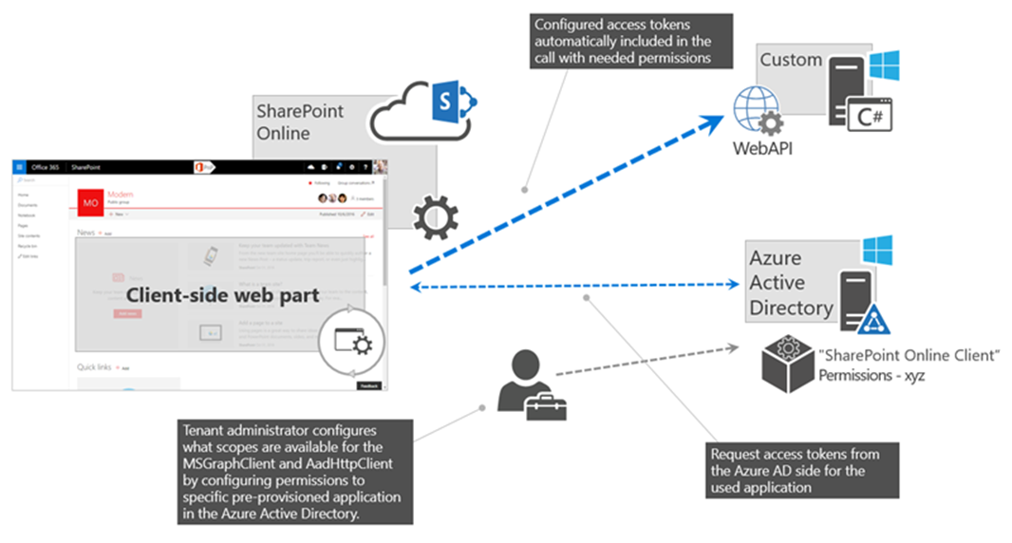
Isolated web parts

Slide 28
Isolated web parts benefits
Web parts from an isolated SPFx package run on a unique domain, hosted within an iFrame - the permissions granted apply only to code hosted on that domain.
Regular SPFx web parts run on your *.sharepoint.com domain, the granted permissions do not apply there.
And since any other SPFx isolated web parts run on a different unique domain, they don't apply there either.
Essentially, the shared application principal for SPFx is not used – instead, an AAD app registration dedicated to this SPFx solution is created and used for authentication.
Note this scope isn’t the individual web part, but the containing solution package.
This is fine however - if you have an untrusted source contributing code to the very same solution/codebase, then you probably have bigger security and governance challenges to deal with quite frankly.
In the ‘config/package-solution.json’ file, set the isDomainIsolated property to true.
"isDomainIsolated": true

Slide 29
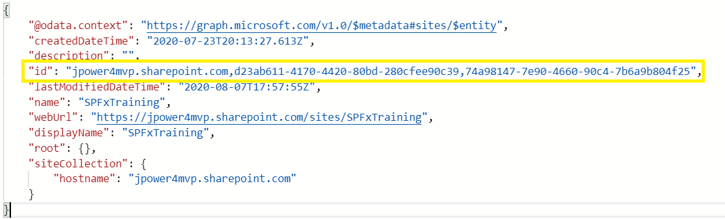
Different Ways to Get SharePoint Site Collection using Microsoft Graph API
We can access the site collection using three different ways in Microsoft Graph API:
By using the root - Get Top level SharePoint site collection by using ‘root’ - sites('root’)
Ex: sites('root')/lists('SPFxContacts')/items?expand=fields
By using the Site server relative URL - sites/jpower4mvp.sharepoint.com:/sites/SPFxTraining
Ex: sites/jpower4mvp.sharepoint.com:/sites/SPFxTraining:/lists/SPFxContacts/items?expand=fields
By using the Site ID
Ex: sites('jpower4mvp.sharepoint.com,d23ab611-4170-4420-80bd-280cfee90c39,74a98147-7e90-4660-90c4-7b6a9b804f25')/lists('SPFxContacts')/items?expand=fields
Get SiteID
To get site id using relative URL in Microsoft Graph Explorer
https://graph.microsoft.com/v1.0/sites/jpower4mvp.sharepoint.com:/sites/SPFxTraining

Slide 30
Demo
Loading SharePoint lists with a Data Service and Mock Service
Custom Property Pane using React
Testing in the local/online workbench
Loading items for the selected list
Fluent UI controls with View and Submit SharePoint Data
Retrieve SharePoint List Items Using Microsoft Graph API for SPFx

Slide 31
References
http://jenkinsblogs.com/2016/08/24/create-a-sharepoint-framework-client-webpart-retrive-list-items/
https://docs.microsoft.com/en-us/sharepoint/dev/spfx/web-parts/get-started/build-a-hello-world-web-part
http://jenkinsblogs.com/2020/04/29/retrieve-sharepoint-list-items-using-microsoft-graph-api-for-spfx/
https://developer.microsoft.com/en-us/graph/graph-explorer#
https://docs.microsoft.com/en-us/graph/api/user-get?view=graph-rest-1.0&tabs=http
https://docs.microsoft.com/en-us/graph/permissions-reference
https://docs.microsoft.com/en-us/sharepoint/dev/spfx/use-msgraph
https://docs.microsoft.com/en-us/sharepoint/dev/spfx/use-aad-tutorial
https://docs.microsoft.com/en-us/sharepoint/dev/spfx/web-parts/isolated-web-parts

Slide 32



SPFx Info
https://docs.microsoft.com/en-us/sharepoint/dev/spfx/sharepoint-framework-overview
Twitter
@ m365pnp
Tech Community
aka.ms/sppnp-community

